Slide 1
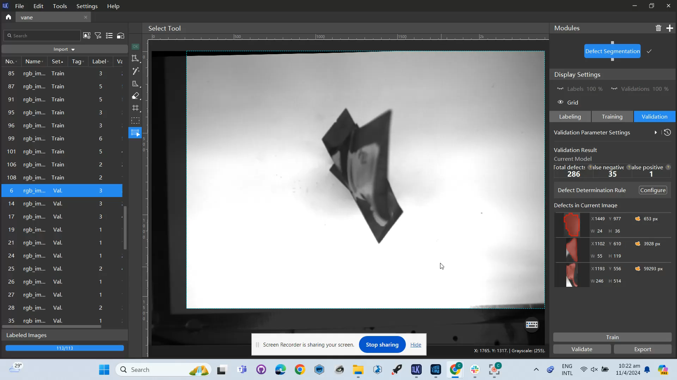
Deep learning model
121 testing, 49 validation (70/30)
FPR = 8/350
FNR = 50/350 (many small blobs marked as defects in training set are in proximity with bigger blobs and thus were identified as part of the big blob, especially when the blade is positioned at an angle)

Slide 2
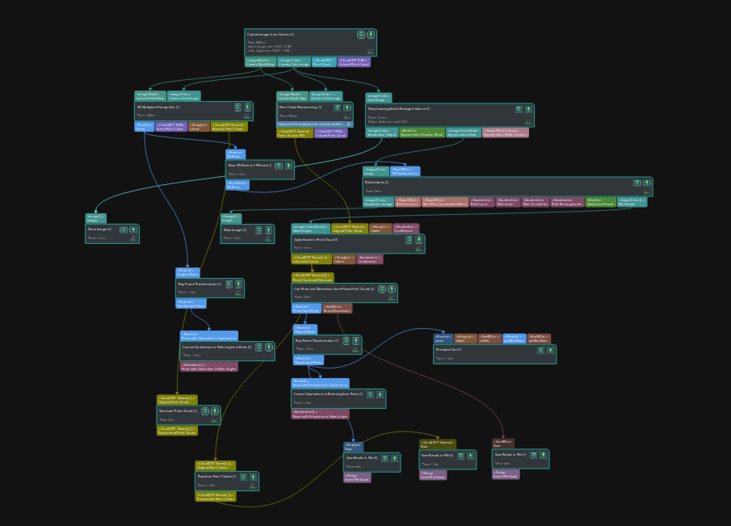
Mech Mind flow
1. RGB camera obtains 2d image and depth map. Generate point cloud
2. Perform workpiece recognition on point cloud to obtain pose of the wobj wrt camera
3. Deep learning model identifies defects on vane, outputs instance segmentation mask
4. Perform blob analysis to get the semantic segmentation masks of individual defects
5. Project mask images onto point cloud, calculate defect poses (wrt camera) through point cloud normal, and obtain the box dimensions of the masked point clouds (pose xyz as the center of the box)
6. Transform all poses and point cloud (object and defect) wrt to robot base, convert orientation values from quaternion to euler angle)

Slide 3
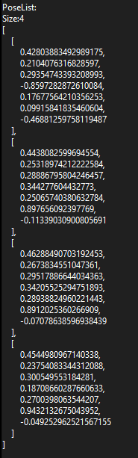
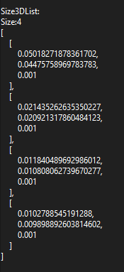
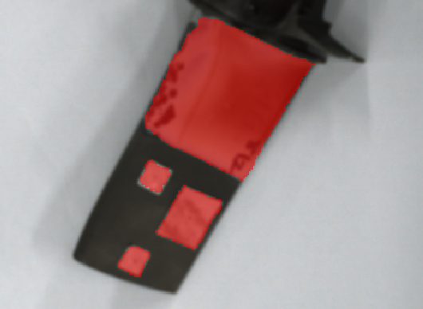
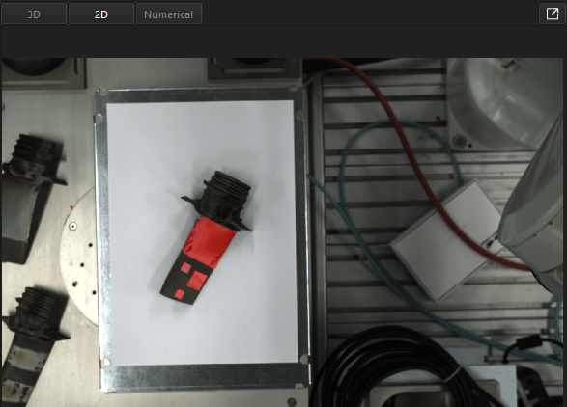
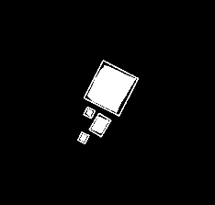
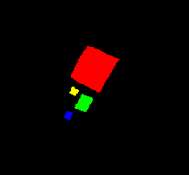
Output
X
Y
Z
q1
q2
q3
w
Instance Segmentation mask images
Masked Point Cloud

Slide 4
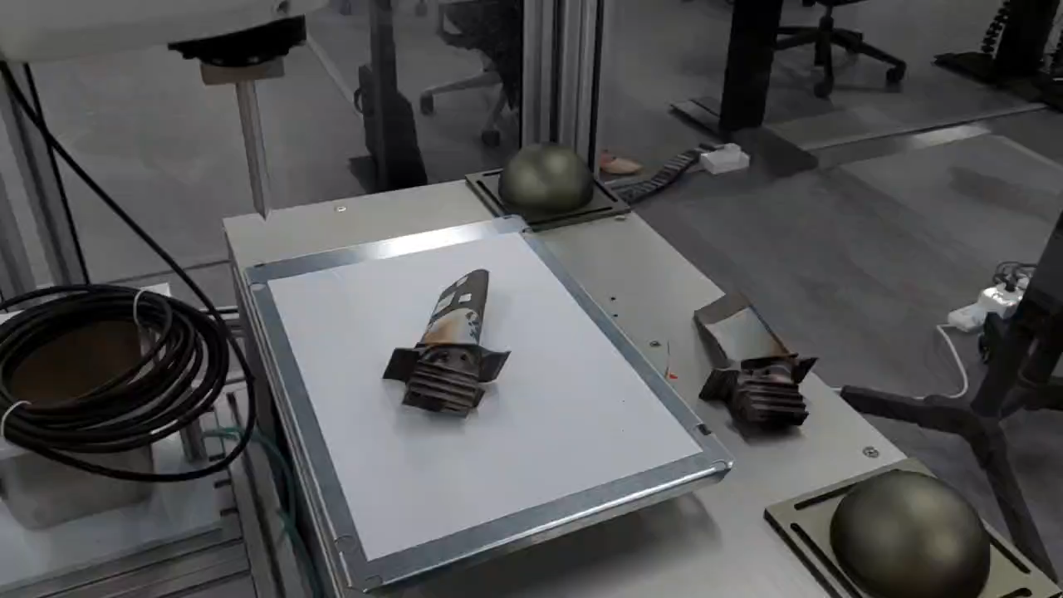
Robot Movement (locked orientation)

Slide 5
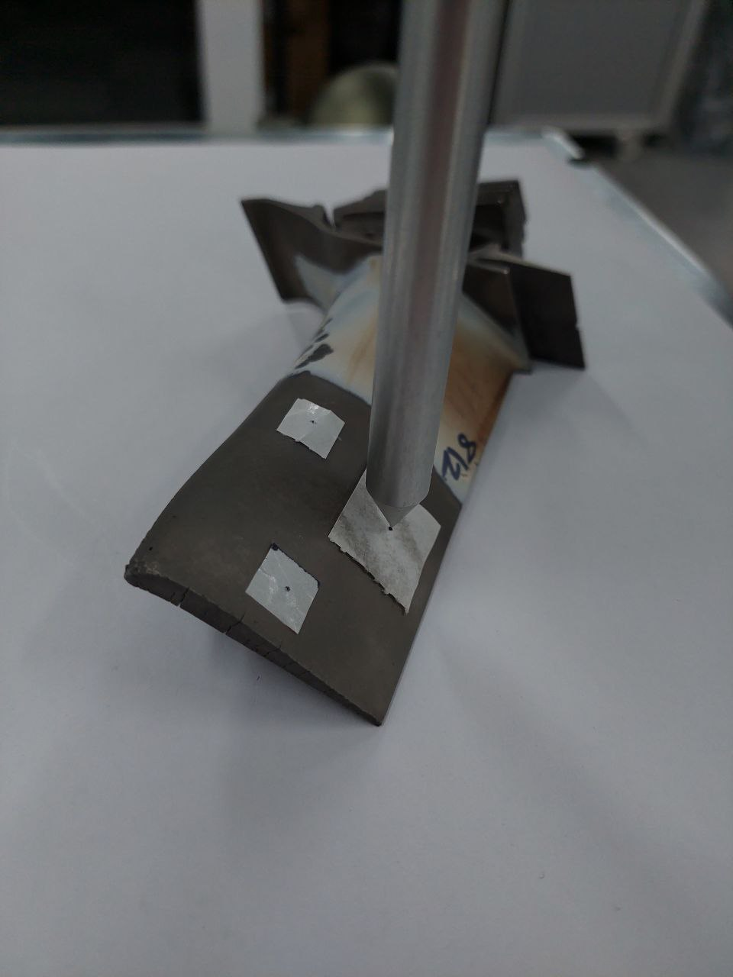
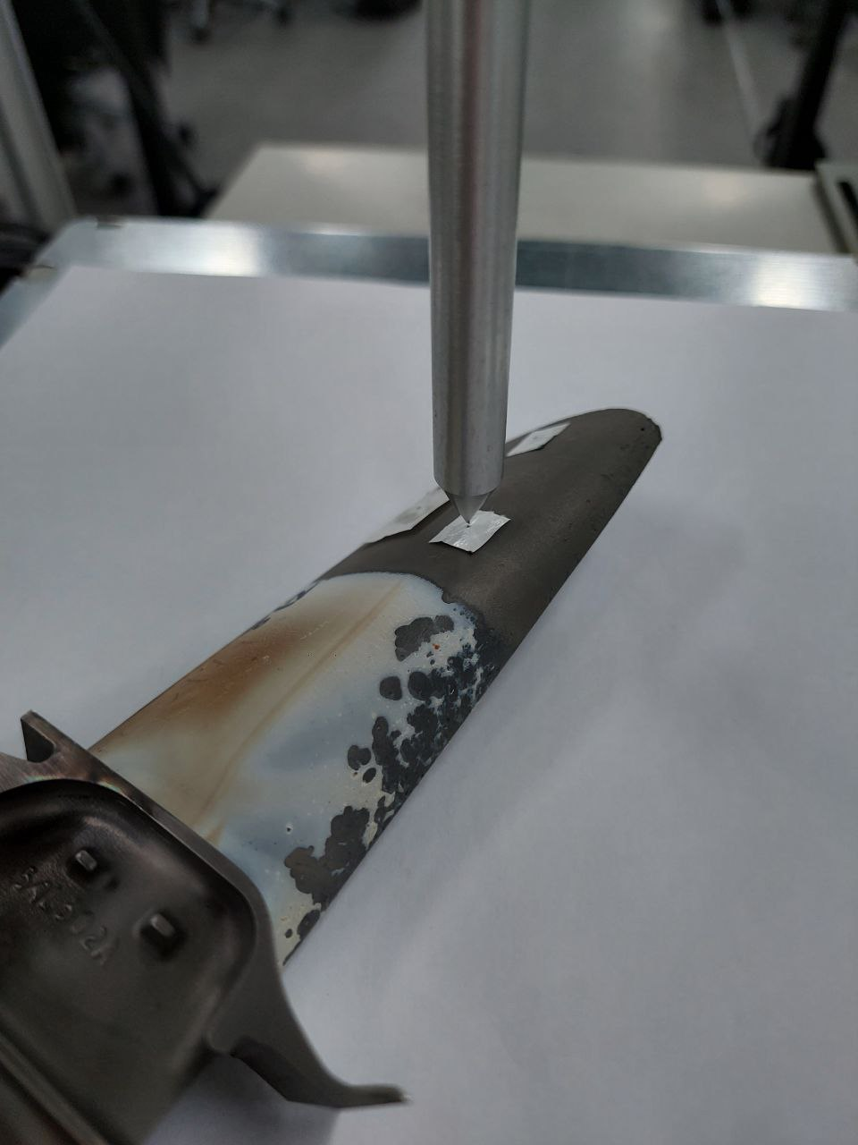
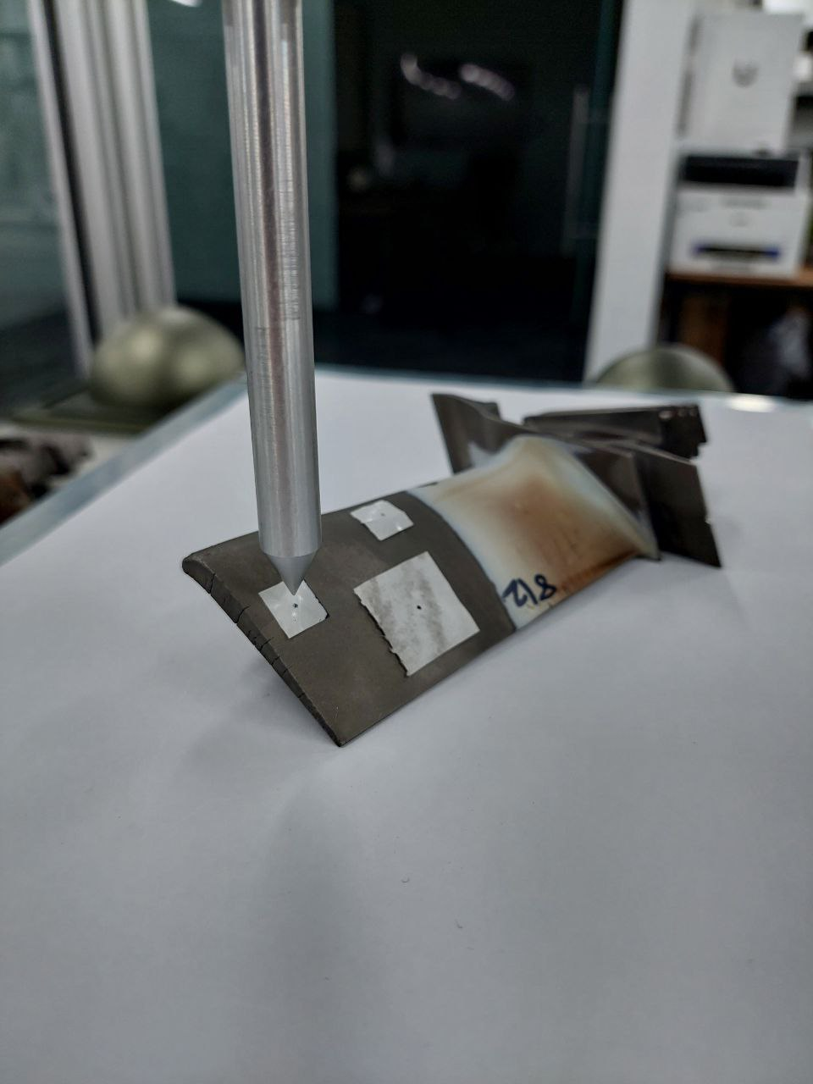
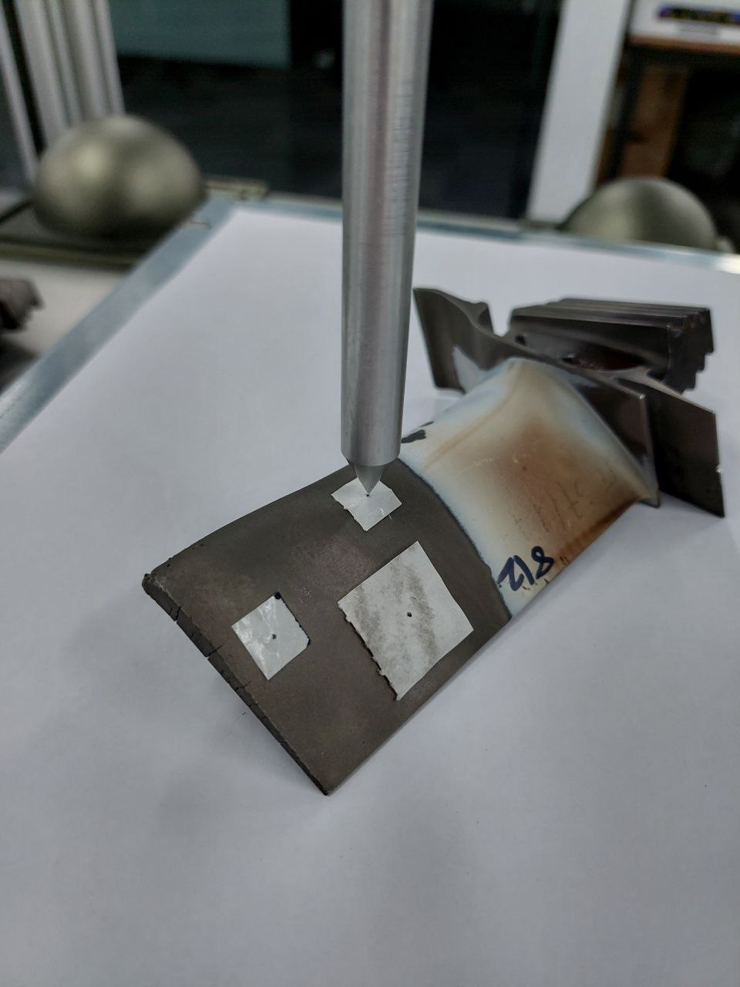
Positional accuracy
Sharp tip goes directly to the center of the defect (denoted by a black dot)

